Slide 1

GOLDILOCKS MEDICINE
Part 1: Tackling Too Much Medicine
Prof Joanne Reeve FRCGP
Professor Emerita, Hull York Medical School

Slide 2
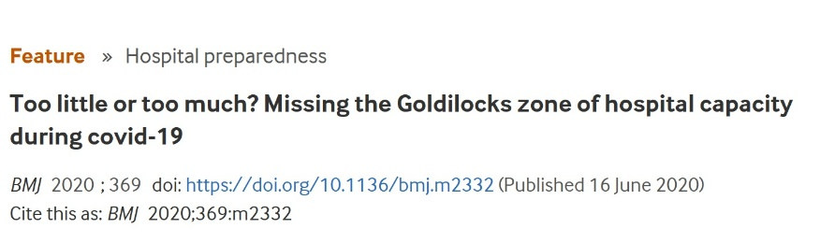
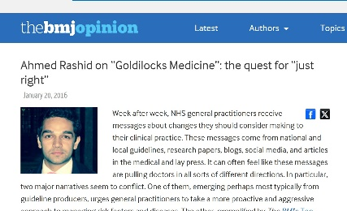

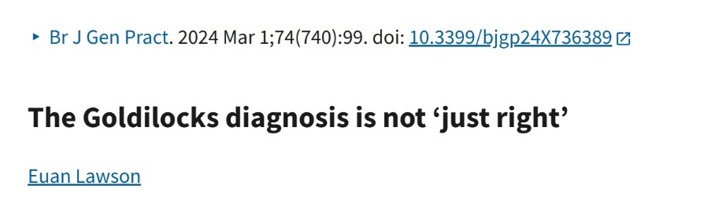

GOLDILOCKS MEDICINE

Slide 3
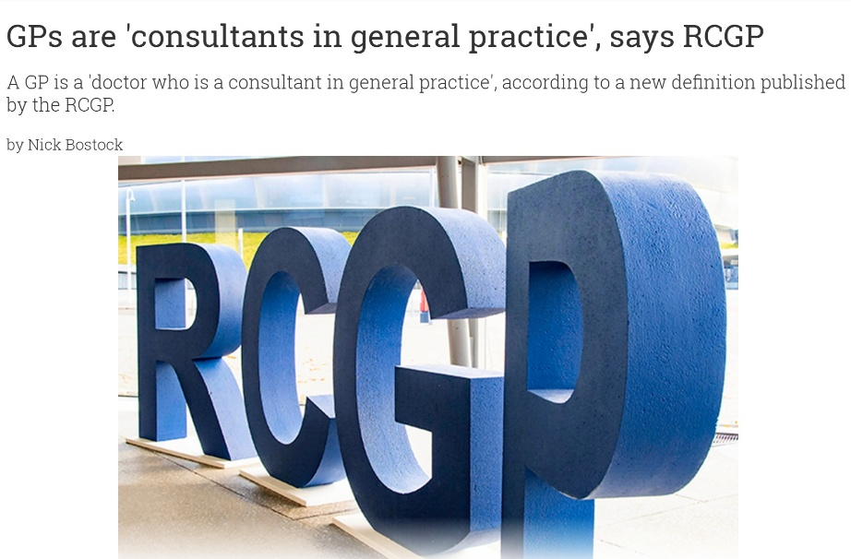
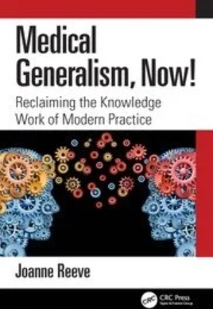
GOLDILOCKS as a Consultant in Advanced Generalist Medicine

Slide 4
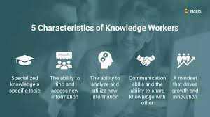
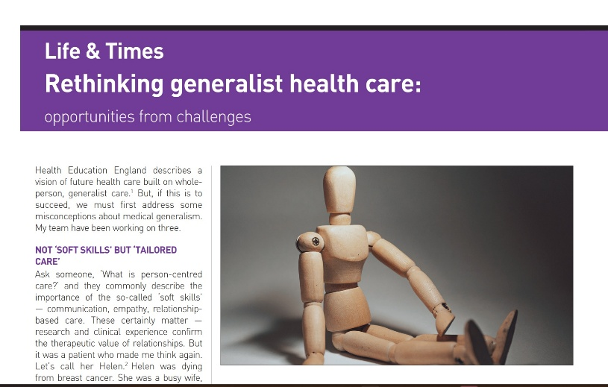
What we’ll be doing today…
Recognising KNOWLEDGE WORK as the distinct element of Advanced Generalist Medicine and general practice
APPLYING KW practice to tackle Too Much Medicine
Inviting you to set your own GOALS for action
Notes:
Knowledge workers are professionals whose primary capital is their expertise, analytical skills, and formal education. Rather than performing physical, materials-based labour, their core tasks involve critical thinking, processing information, and creative problem-solving. They are paid "to think" and innovate.
https://en.wikipedia.org/wiki/Knowledge_worker
Rethinking generalist health care: opportunities from challenges. Joanne Reeve
British Journal of General Practice 2022; 72 (720): 338-339. DOI: https://doi.org/10.3399/bjgp22X719993
https://bjgp.org/content/bjgp/72/720/338.full.pdf
From soft skills to tailored care
From jack of all trades to expert knowledge worker
From integration to new design

Slide 5
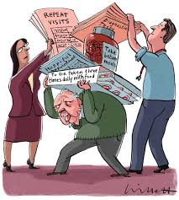
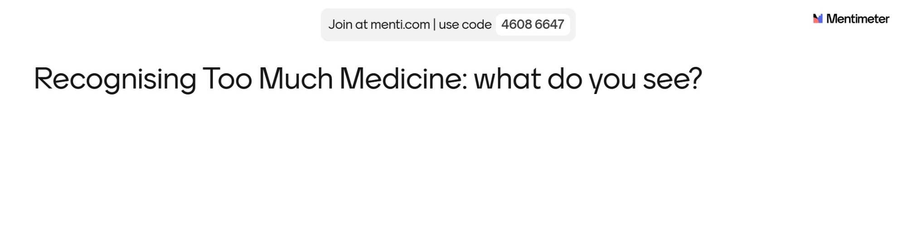
GOLDILOCKS and Too Much Medicine
www.menti.com
Code: 4609 6647
BMJ 2009; 339: 486-487

Slide 6
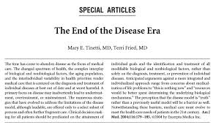
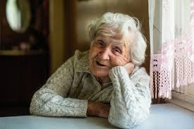
GOLDILOCKS and Too Much Medicine
Introducing Edna
BMJ 2009; 339: 486-487
Notes:
Tinetti & Fried The end of the Disease Era
Am J Med . 2004 Feb 1;116(3):179-85.
doi: 10.1016/j.amjmed.2003.09.031

Slide 7

WHY WE NEED WHOLE PERSON MEDICINE - AGM
FOCUS ON PERSON, NOT THE DISEASE: diagnosis, tmt/mmt decisions, follow up and review
TAILORED: evidence INFORMED not driven
Defined not by guideline but expertise of clinician& pt creating new KNOWLEDGE IN CONTEXT - the KNOWLEDGE WORK of agm
Just as scientific – but a DIFFERENT SCIENCE
Supports HEALTH FOR DAILY LIVING
Notes:
KNOWLEDGE WORK IN CONTEXT
Gabbay J, le May A. 2004
Evidence based guidelines or collectively constructed mindline. Ethnographic study of knowledge management in primary care
https://www.bmj.com/content/329/7473/1013
Mindlines: making sense of evidence in practice
John Gabbay and Andrée le May 2016
British Journal of General Practice 2016; 66 (649): 402-403. DOI: https://doi.org/10.3399/bjgp16X686221
Donner Banzhoff, Hertwig R 2014
Inductive foraging: improving the diagnostic yield of primary care consultations
Eur J Gen Pract . 2014 Mar;20(1):69-73. doi: 10.3109/13814788.2013.805197
https://pubmed.ncbi.nlm.nih.gov/23815336/
MacKelvie S 2021
Clinical decision making in uncertainty; an ethnography of a complex intervention in the ambulatory emergency care setting
https://eprints.soton.ac.uk/482279/
Clinicians use cognitive flexibility and contextual adroitness to manage cognitive and emotional load of working in high clinical uncertainty
Reeve J 2024
Medical Generalism, Now! Reclaiming the knowledge work of modern practice
https://www.routledge.com/Medical-Generalism-Now-Reclaiming-the-Knowledge-Work-of-Modern-Practice/Reeve/p/book/9781032272900?gad_source=1&gad_campaignid=23526953194&gbraid=0AAAAACWuhHV0YJzlxBZSD8uYlpoIF9Tck&gclid=Cj0KCQjwrZTRBhDSARIsAHidYfcTq8uyca7W1Yvw0hZglGji9p7xsVO3YQ8-wG1BT8Dq6FQPbig2kpgaAsLEEALw_wcB
HEALTH FOR DAILY LIVING
Health as a resource for everyday life: advancing the conceptualisation.
Williamson & Carr
https://www.tandfonline.com/doi/abs/10.1080/09581590802376234

Slide 8
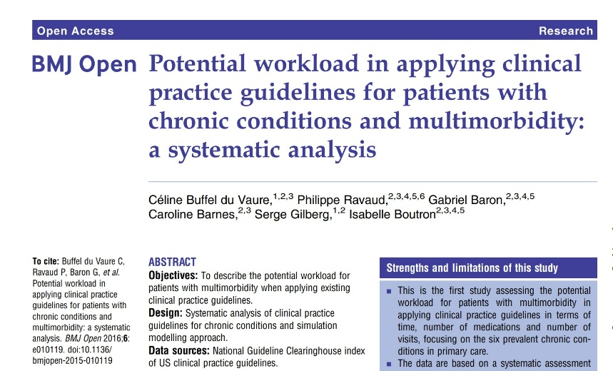
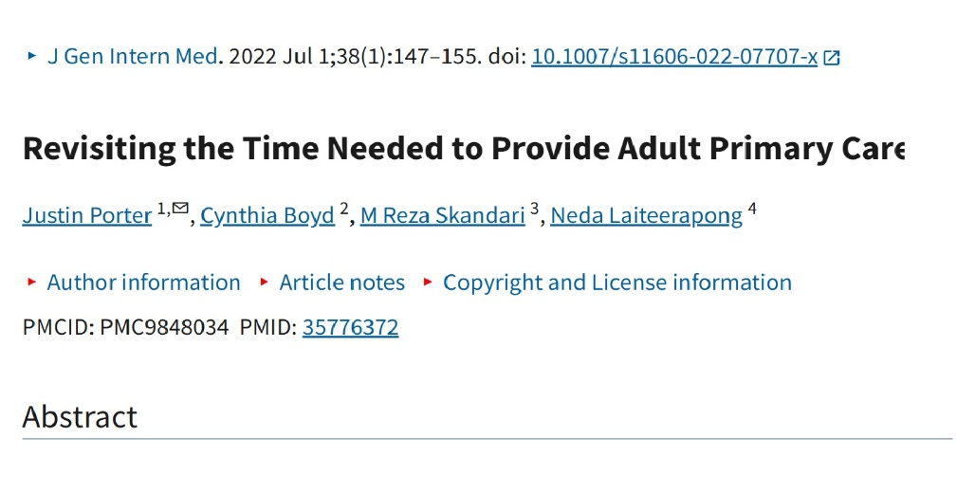
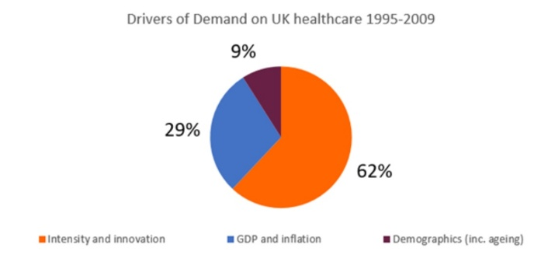
WHAT HAPPENS IF WE DON’T?
BURDEN
BURNOUT
BLAZING NHS
Notes:
BURDEN
https://bmjopen.bmj.com/content/6/3/e010119
BURNOUT
https://pmc.ncbi.nlm.nih.gov/articles/PMC9848034/
BLAZING NHS
https://www.hsj.co.uk/service-redesign/what-have-nobel-prize-winners-ever-done-for-us/7027119.article

Slide 9
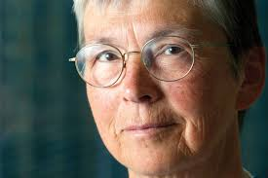
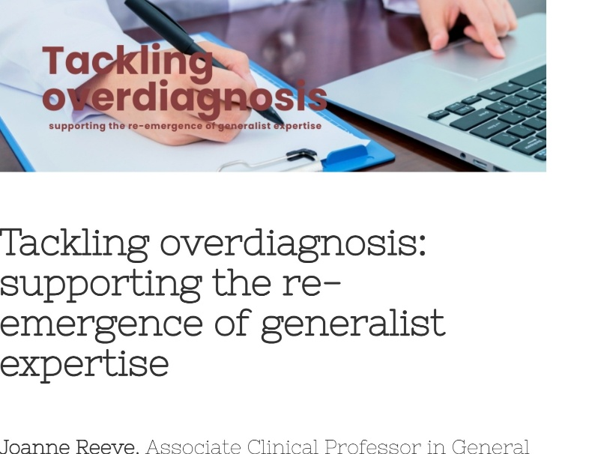
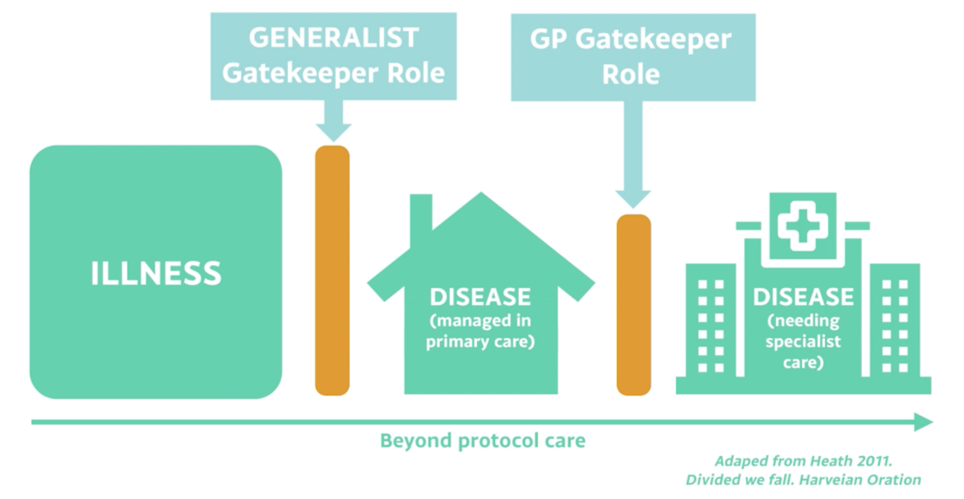
Re-introducing the GENERALIST GATEKEEPER
Notes:
TACKLING OVERDIAGNOSIS: supporting the re-emergence of the generalist expertise
Reeve J
https://bhma.org/tackling-overdiagnosis-supporting-the-re-emergence-of-generalist-expertise/
DIVIDED WE FAIL (Harveian Oration)
Heath I.
Clin Med (Lond) . 2011 Dec;11(6):576–586. doi: 10.7861/clinmedicine.11-6-576

Slide 10
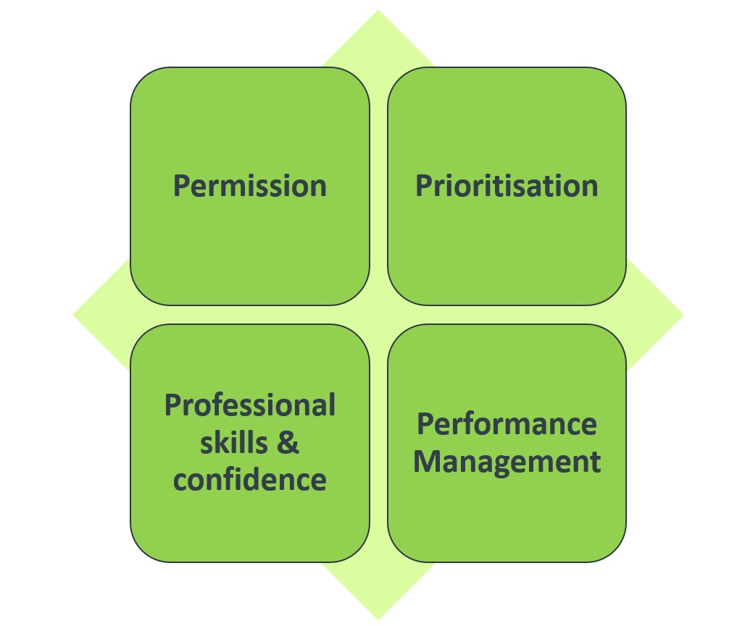
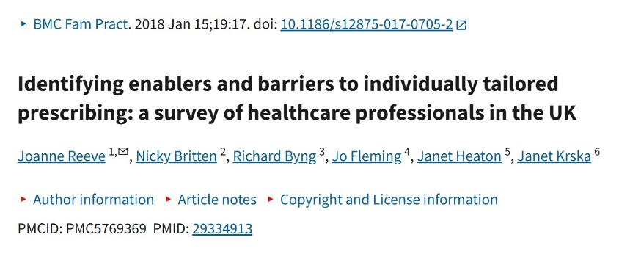
BARRIERS: why we don’t do this…
Notes:
https://pmc.ncbi.nlm.nih.gov/articles/PMC5769369/

Slide 11


Slide 12
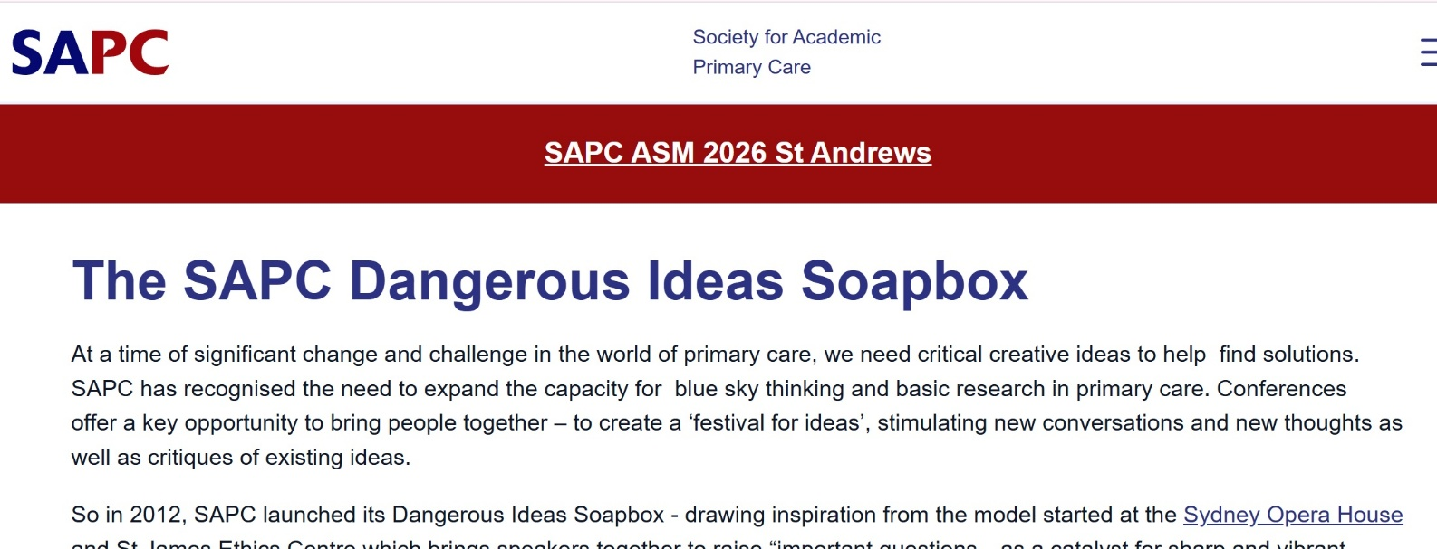
DANGEROUS IDEAS – STARTING WITH A ZINE
Notes:
https://sapc.ac.uk/article/sapc-dangerous-ideas-soapbox

Slide 13
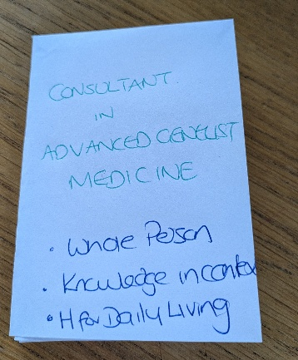
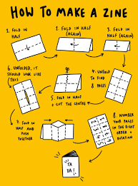
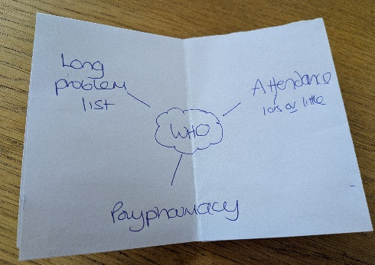
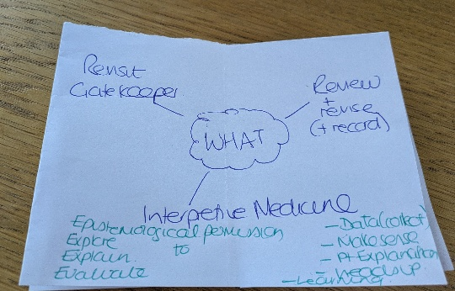
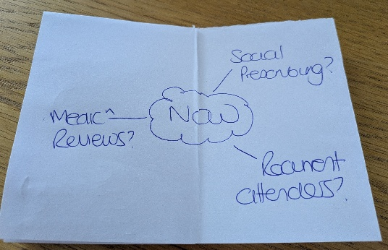
DANGEROUS IDEAS – STARTING WITH A ZINE
Notes:
https://www.42ndstreet.org.uk/support/read/how-to-make-your-own-zine/

Slide 14

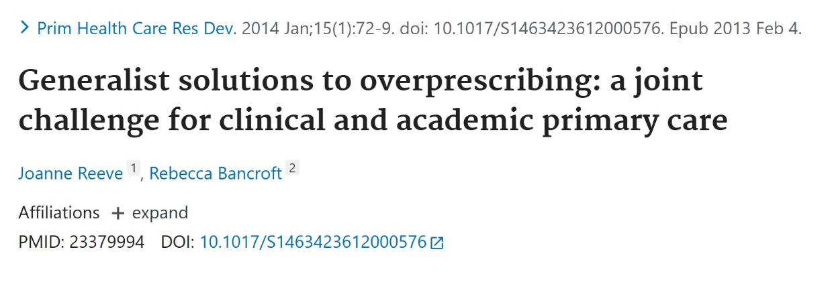
FROM IDEA TO ACTION: THE COMPLEX NEEDS PROJECT
Notes:
https://pubmed.ncbi.nlm.nih.gov/23379994/

Slide 15
FROM IDEA TO ACTION: THE COMPLEX NEEDS PROJECT
WHO: permission to prioritise an at-risk group
WHAT: dedicated resources (4Ps) to
  See person in context
  Generalist Gatekeeper
  Apply Interpretive Medicine
  Change clinical record
  Review and revise (for patient and practice)
Notes:
https://pubmed.ncbi.nlm.nih.gov/23379994/

Slide 16
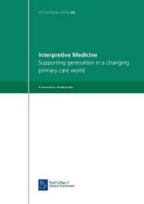
COMPLEX NEEDS PROJECT : INTERPRETIVE MEDICINE
Collect the DATA you need
Review through the LENS of WPM
Apply AGM to create EXPLANATION IN CONTEXT (decisions)
Immediate HEADS UP what have I missed, would I do the same for…
REVIEW & REVISE reappraise
Notes:
INTERPRETIVE MEDICINE
https://pubmed.ncbi.nlm.nih.gov/21805819/
EXPLORATORY DECISION MAP
https://pmc.ncbi.nlm.nih.gov/articles/PMC3184534/
SAGE consultation model: https://bjgp.org/content/65/633/207

Slide 17
FROM IDEA TO ACTION: THE COMPLEX NEEDS PROJECT
IMPACT
  2/3 clinically significant change
  Predictors of change: social factors, mental health, recent change
  Impact on staff: 3Ms
Notes:
See more in…
Generalist solutions to overprescribing: a joint challenge for clinical and academic primary care
Reeve & Bancroft. Prim Health Care Res Dev 2014; 15: 72-79
https://pubmed.ncbi.nlm.nih.gov/23379994/

Slide 18
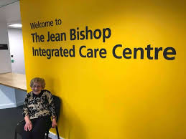

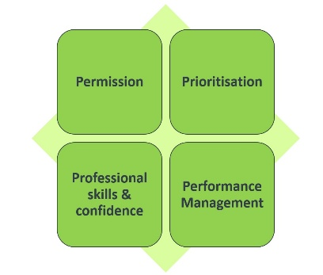

Widely used now – what’s near you?
Strengths & Limitations?
What would you do differently?
What would stop you? (4Ps)

Slide 19


But hang on - is this evidence based….
TAILOR looked at Deprescribing
Key points:
Structured deprescribing safe (Permission to deprescribe/demedicalise)
Needs DExTruS framework to support (data, knowledge work, team effort – the other 3Ps)
Notes:
https://evidence.nihr.ac.uk/alert/how-to-safely-deprescribe-medications-for-people-with-multiple-long-term-conditions/
https://learn.nihr.ac.uk/

Slide 20

NOW WHAT??

Slide 21
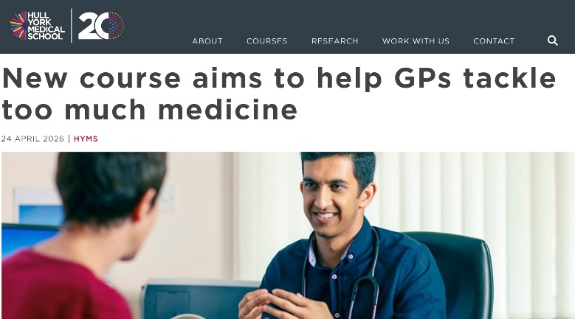



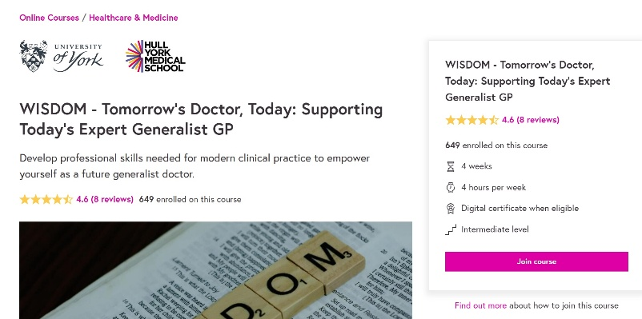
EXPLORING MORE…
Notes:
https://www.hyms.ac.uk/about/news/2026/new-course-aims-to-help-gps-tackle-too-much-medicine
https://www.hyms.ac.uk/continuing-professional-development/tailored-care-tackling-too-much-medicine
https://www.futurelearn.com/courses/wisdom-skills-for-the-future-generalist-doctor
https://learn.nihr.ac.uk/

Slide 22
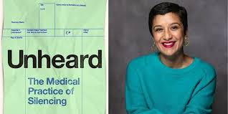
NEXT TIME…
MY EMAIL
joanne.reeve@hyms.ac.uk

